Slide 1

General Presentation
2012

Slide 2




Xeltek Overview
Founded in 1985
Headquarter: Silicon Valley, USA
Corporate office: Sales, Marketing, and Customer Support
Engineering & Manufacturing: Asia
Large engineering teams enable quick device algorithm support and constant new product development
Industry Leader:
Widest range of programming solutions:
Cluster programmers (new technology in flexible volume manufacturing)
High performance stand-alone Universal programmers
In-System programmers
Gang Programmers
Fully automated programming system

Slide 3


















Xeltek Customers
Our customers add value to their products through software and we support their programming needs for engineering development
Broad customer base which spans over multiple industries
Here are just a few customers:
…and many more!

Slide 4
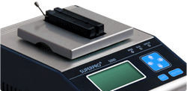
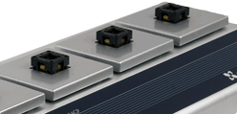
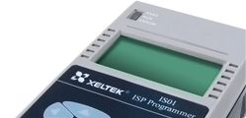
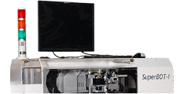
Industry Leader
Widest range of programming solutions:
Cluster programmers (new technology in flexible volume manufacturing)
High performance stand-alone Universal programmers
Gang Programmers
In-System programmers
Fully automated programming system
Universal
programmers
Production
programmers
In-System
programmers
Automated
programmers
SuperPro 5000
SuperPro 5000E
SuperPro 7000
SuperPro 501S
SuperPro 500P
SuperPro M NEW!
SuperPro 5004GP
SuperPro 5004EGP
SuperPro 5000E Cluster
SuperPro 501S Cluster
SuperPro IS01
SuperPro IS02 NEW!
SuperPro 3070
SuperBOT I

Slide 5
Technology Highlights
79,300+ devices supported (Largest in the industry)
Cluster programmer technologies (Flexible volume manufacturing
(1-15 sockets)
Built-in 144 Universal pin-drivers
Operates in Stand-alone or PC connected (USB2.0)
High speed ARM 7/9/11 RISC processor
Stand-alone In-System Programming
Fully automated desktop programming system

Slide 6
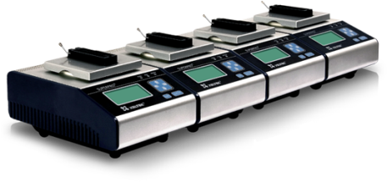
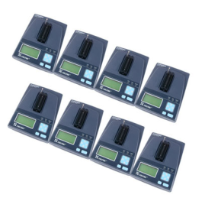
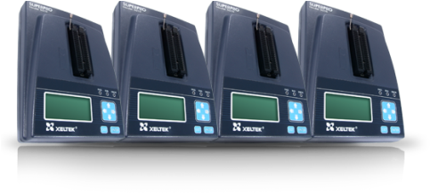
Cluster Programming
Best design for volume production!
Flexibility & expandability from 1 - 15 sockets
Repair service will not shut down production line
No PC required, No experienced PC operator required
Cluster Technology Solution
Just add another module when volume production increase. It is that simple!
Only the affected module is sent back for repair and production continues
Save cost, no PC malfunction → increase reliability, minimize operator mistakes
4. Safeguard confidential user data in the compact flash card by storing it in a safe place at the end of the day

Slide 7
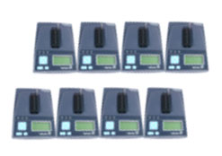
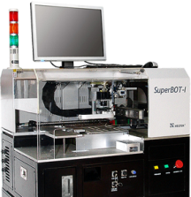
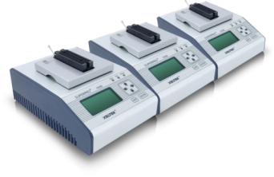
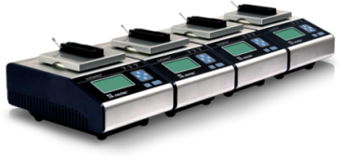
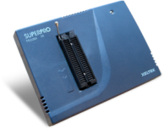
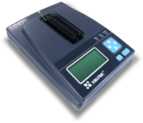
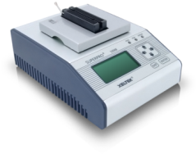
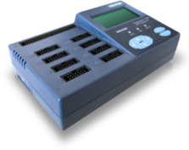
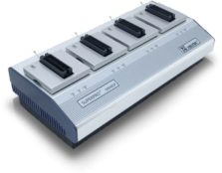
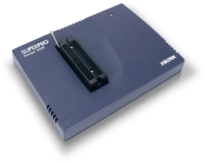
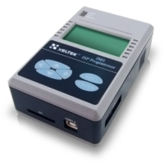
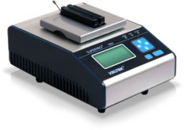
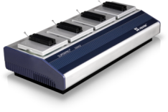
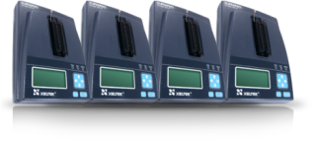
Programming Solution for Every Budget
SUPERPRO 501S Cluster
36,000+
SUPERPRO 5000E
69,000+
SUPERPRO 5000
79,300+
SUPERBOT-I
new
SUPERPRO M
$ 595
SUPERPRO 501S
$ 899
SUPERPRO 5000E
$ 1,495
SUPERPRO ISO2
$ 1,995
SUPERPRO 5004EGP
$ 4,495
SUPERPRO 500P
$ 799
SUPERPRO ISO1
$ 1,195
SUPERPRO 5000
$ 1,995
SUPERPRO 501S 4C
$3596
SUPERPRO 5004GP
$ 6,295
Entry Level
Engineering Development
Production

Slide 8
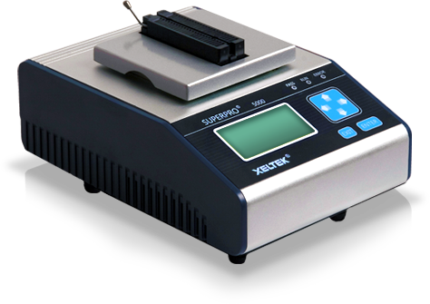

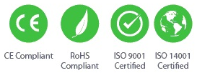
SuperPro® 5000
Ultra-fast 144 Pin Stand-alone Universal Programmer
Cluster 1-15 units for volume production
Over 79,300 devices supported
Operates in Stand-alone or PC connected (USB2) mode
Built-in 144 universal pin-driver
Ultra-fast ARM7 RISC MCU processor, Linux O/S
Programs 64Mb NOR Flash memory in 11.3 sec
Win XP/Vista/7 32/64 bit compatible
Project file storage in a removable Compact Flash card (optional)

Slide 9
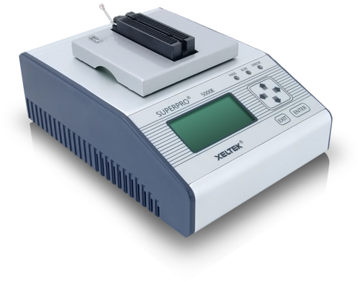
SuperPro® 5000E
Ultra-fast 144 Pin Stand-alone Universal Programmer (Economy Version)
Over 69,300 devices supported
Other characteristics same as SuperPro 5000

Slide 10
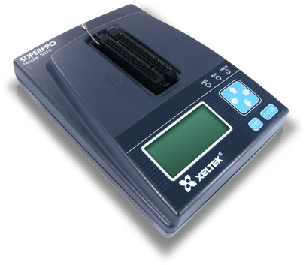
SuperPro® 501S
Ultra-fast 48 Pin Stand-alone Universal Programmer
Cluster 1-15 units for volume production
Support over 36,900 devices
Operates in Stand-alone or PC connected (USB2) mode
Built-in 48 universal pin drivers
Ultra-fast ARM7 RISC MCU processor, Linux O/S
Programs 64Mb NOR Flash memory in 11.3 seconds
Win XP/Vista/7 32/64 bit compatible
Project file storage in a removable Compact Flash card (optional)

Slide 11
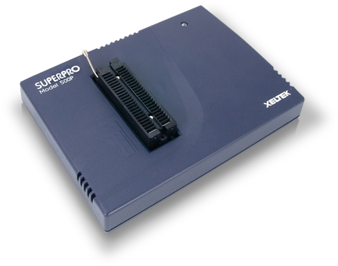
SuperPro® 500P
Low Cost 48 Pin Stand-alone Universal Programmer
Supports over 30,300 devices
Built-in 48 universal pin drivers
Ultra-fast ARM7 RISC MCU processor, Linux O/S
Programs & verifies 64 Mb NOR Flash memory in 11.3 seconds.
Win XP/Vista/7 32/64 bit compatible

Slide 12
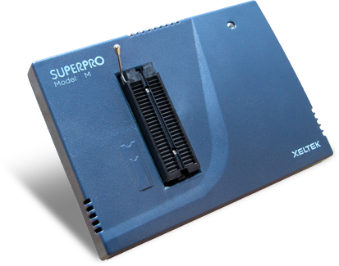
SuperPro® M
Low Cost 48 Pin Universal Programmer
NEW!!!
Supports 20,000+ devices
Ultra-fast ARM7 RISC MCU processor, Linux O/S
Built-in 48 universal pin drivers
PC connected (USB2) mode
Win XP/Vista/7 32/64 bit compatible

Slide 13
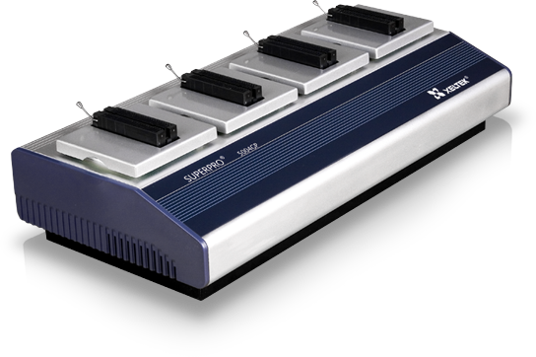
SuperPro® 5004GP
Ultra-fast 144 Pin Stand-alone Universal Gang Programmer
Supports over 79,300 devices
Built-in 144 universal pin drivers
Ultra-fast ARM7 RISC MCU processor, Linux O/S
Programs 64Mb NOR Flash memory in 11.3 sec
4 independent programming modules (Operates concurrently for high speed programming )
Win XP/Vista/7 32/64 bit compatible

Slide 14
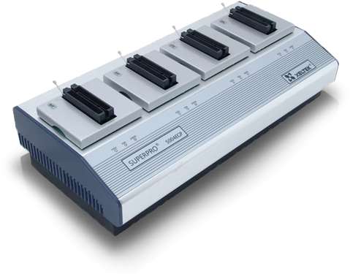
SuperPro® 5004EGP
Ultra-fast 144 Pin Stand-alone Universal Gang Programmer (Economy Version)
Supports over 69,900 devices
Built-in 144 universal pin drivers
Ultra-fast ARM7 RISC MCU processor, Linux O/S
Programs 64Mb NOR Flash memory in 11.3 sec
4 independent programming modules (Operates concurrently for high speed programming )
Win XP/Vista/7 32/64 bit compatible

Slide 15
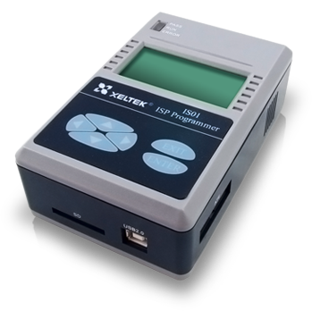
SuperPro® ISO1
In-system Stand-alone Programmer
Built-in ARM9 32Bit RISC MCU processor (Fastest ISP programmer in the industry)
Operates in Stand-alone or PC connected (USB2) mode
DLL function available for user modification (Optional)
Speed adjustable to suit target environment
In-system programming of microcontrollers and serial E(E)proms (ATMEL AVR, Microchip PIC Series…)
Automatic Test Equipment (ATE) interface (For automated operation)
Win XP/Vista/7 32/64 bit compatible
Project file storage in a removable Secure Digital card (Optional)
Compact-size 137mm(L) x 87mm(W) x 47mm(H)

Slide 16
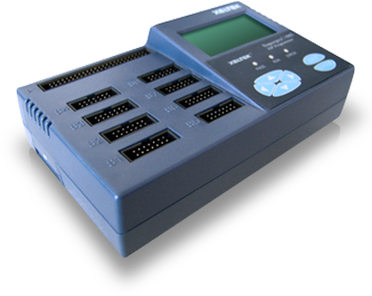
SuperPro® ISO2
8 Serial & 1 Parallel In-system Stand-alone Gang Programmer
Built-in ARM9 RISC MCU processor (Fastest ISP programmer in the industry)
Operates in Stand-alone or PC connected (USB2) mode
In-Circuit Equipment (ATE) interface for automated factory operation
Supports 8 serial & 1 parallel chip programming
Win XP/Vista/7 32/64 bit compatible
Device support done upon user request (Contact factory for device support)
Project file storage in a removable Secure Digital card (Optional)
NEW!!!

Slide 17
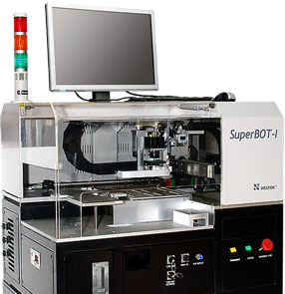
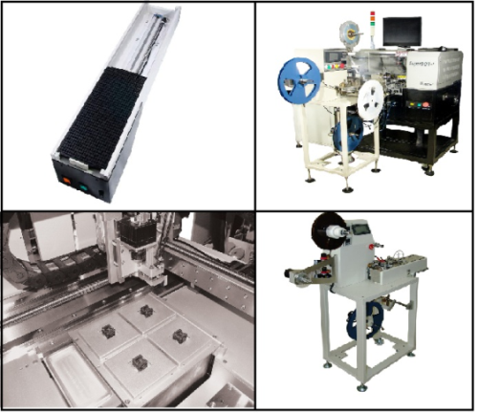
SuperBOT1®
Automated Universal IC Programming System
79,900+ devices(Built-in SuperPro5004GP)
Low cost high volume production
High throughput (1400 devices/hour max)
Single Tray In / Out
Camera assisted device placement
Quick device updates (Less than 2 weeks)
20 Tray Auto Loader System (Optional)
Tape/Reel In/Out System (Optional)
Tube In/Out attachments (Optional)
Laser Marker (Optional)
Contact us for
Quotation & Information

Slide 18
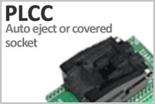
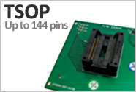
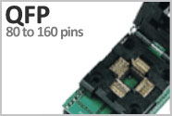

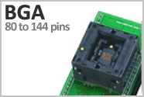
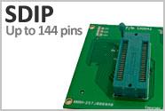
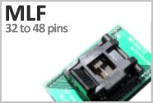
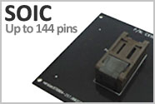
Socket Adapters
Xeltek manufactures a broad line of socket adapters to support a wide range of IC chip’s package type.
Online Device Search Tool

Slide 19
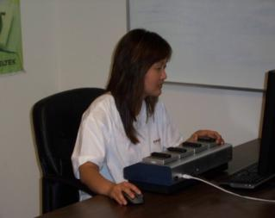
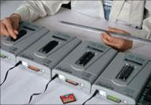
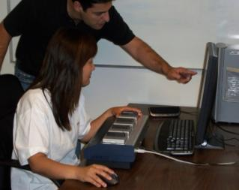
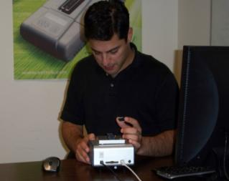
Unbeatable Support
Two engineering teams devoted to customer support provide fast turnaround times - USA, China
Same day phone/email support
Same day shipping on most orders
Live Chat, Ticket Tracking System
Quick device update (2 weeks upon customer request)
FAQ / Forum / Blogs
Bi-weekly software updates (Free download)
2 YR warranty (Optional premium upgrade)

Slide 20








Get in touch with us
Your Partner for Cost Effective Device Programming Solutions
1296 Kifer Rd. Suite # 605
Sunnyvale, CA 94086, USA
Tel: (408)530-8080
Fax: (408)530-0096
Email: info@xeltek.com
Facebook.com/xeltek
Twitter.com/SuperPro
www.xeltek.com

Slide 21


